Slide 1

Using Agentic AI to Prioritize CERT C Findings in Embedded Systems
Daniel Liezrowice – Agentic AI for CERT C – AI Hacking Village 2025

Slide 2
Using Agentic AI to Prioritize CERT C Findings in Embedded Systems
Agenda:
• Static analysis severity ≠ real risk
• Agentic AI finds actual critical flaw
• Live Demo in a realistic development System
Daniel Liezrowice – Agentic AI for CERT C – AI Hacking Village 2025

Slide 3

Embedded Systems Context
• MCUs use mainly the C language for determinism
• Using the C language = Direct HW access, low memory footprint, speed
But also, many pitfalls and safety and stability problems
• That is why we have Safety and regulation constraints
In the form of strict, enforceable “coding Standards”
Daniel Liezrowice – Agentic AI for CERT C – AI Hacking Village 2025

Slide 4



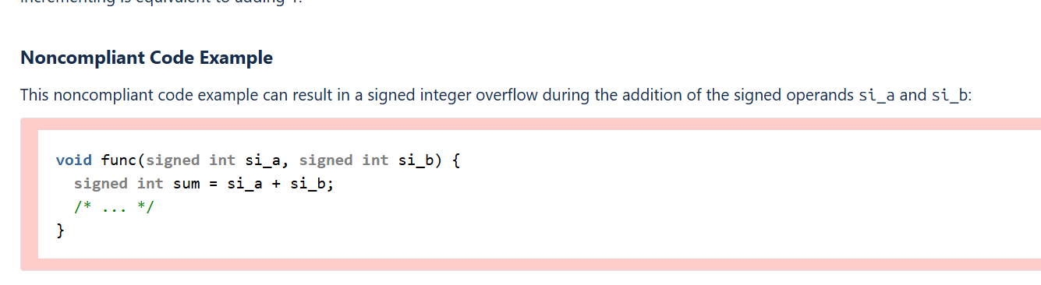
Why CERT C Is Important
• Prevents undefined behavior
• Hardens security
• Complements MISRA C
Daniel Liezrowice – Agentic AI for CERT C – AI Hacking Village 2025

Slide 5
Why CERT C Is Important
• Prevents undefined behavior
• Hardens security
•According to ISO C, a call to malloc(0) has one of two allowed behaviors:
It returns a null pointer.
It returns a unique pointer value that can be passed to free,
but the pointer must not be dereferenced.
The standard does not guarantee which behavior occurs.
Different implementations behave differently.
Daniel Liezrowice – Agentic AI for CERT C – AI Hacking Village 2025

Slide 6
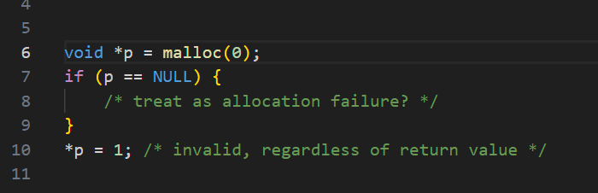
Why CERT C Is Important
• Prevents undefined behavior
• Hardens security
•According to ISO C, a call to malloc(0) has one of two allowed behaviors:
It returns a null pointer.
It returns a unique pointer value that can be passed to free,
but the pointer must not be dereferenced.
The standard does not guarantee which behavior occurs.
Different implementations behave differently.
Daniel Liezrowice – Agentic AI for CERT C – AI Hacking Village 2025

Slide 7
Why CERT C Is Important
• Prevents undefined behavior
• Hardens security
•Problem: Code that interprets malloc(0) returning non-null as “successful allocation”
may later dereference it, which is undefined behavior.
Daniel Liezrowice – Agentic AI for CERT C – AI Hacking Village 2025

Slide 8
Why CERT C Is Important
• Prevents undefined behavior
• Hardens security
•CERT C rule that addresses this: MEM04-C. Do not make assumptions about the result of allocating zero bytes.
What the rule requires: The rule states that code must not rely on the pointer returned by malloc(0)
having usable storage. It also states that both outcomes (NULL or non-NULL)
must be handled consistently and safely.
Daniel Liezrowice – Agentic AI for CERT C – AI Hacking Village 2025

Slide 9
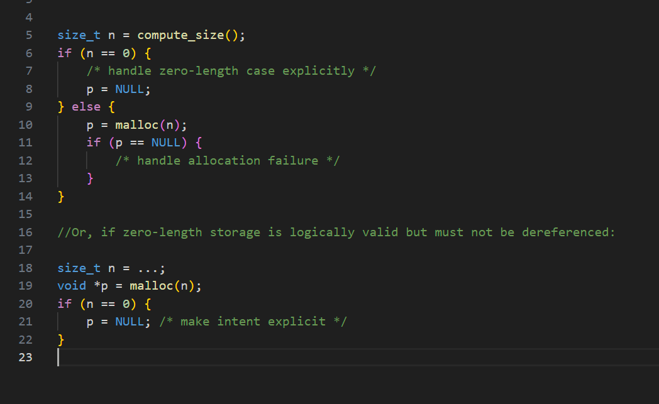
Why CERT C Is Important
• Prevents undefined behavior
• Hardens security
•Correct mitigation:
Daniel Liezrowice – Agentic AI for CERT C – AI Hacking Village 2025

Slide 10
Why CERT C Is Important
• Prevents undefined behavior
• Hardens security
malloc(0) is not undefined by itself, but its behavior is not fully specified.
Using the returned pointer as if real storage were
allocated leads to undefined behavior.
CERT C rule MEM04-C ensures that developers do not rely on this
ambiguous and potentially dangerous construct.
Daniel Liezrowice – Agentic AI for CERT C – AI Hacking Village 2025

Slide 11
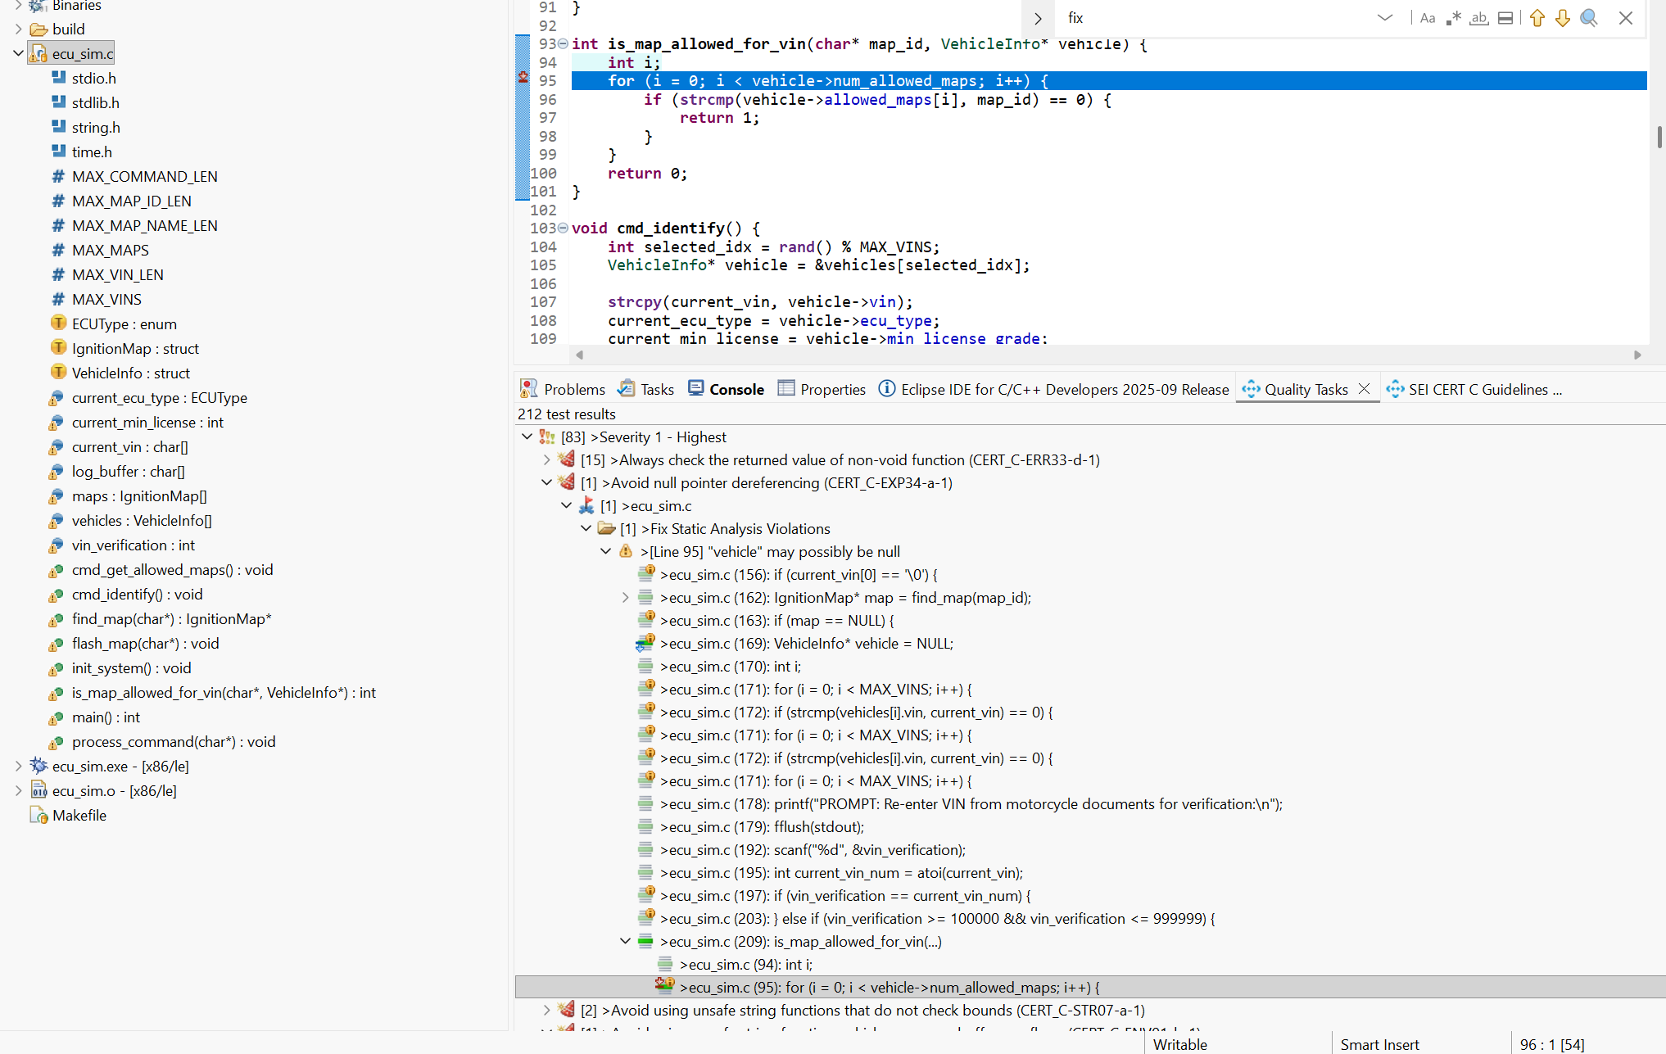
e
Limits of Static Analysis
Enforcement is done with Static Code Analysis tools that in turn have their own problems
• Understands code only
• Severity is theoretical
• No business/regulation context
Daniel Liezrowice – Agentic AI for CERT C – AI Hacking Village 2025

Slide 12
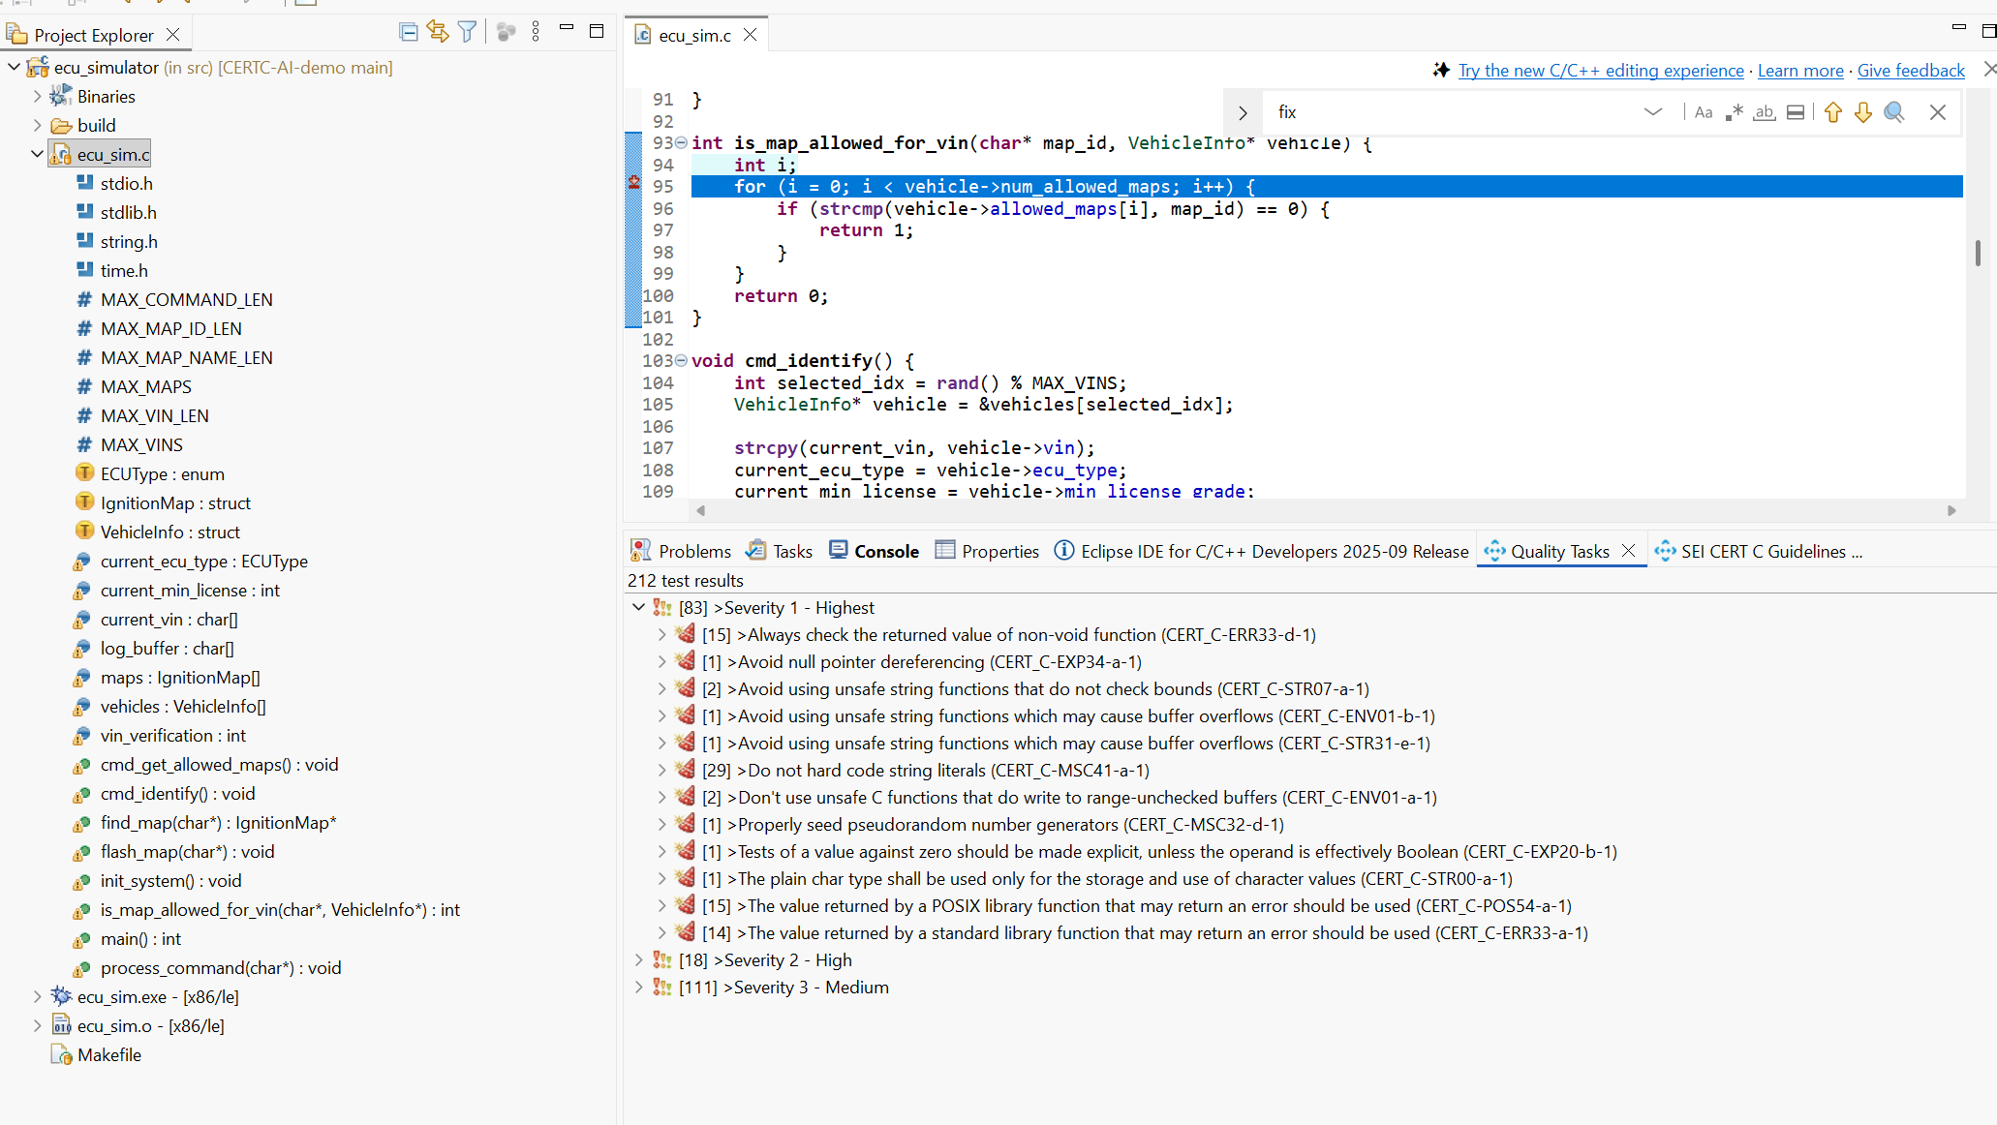
Severity Is Not Real Risk
• High severity may be harmless
• Medium severity may be catastrophic
• Tools miss real-world impact
Daniel Liezrowice – Agentic AI for CERT C – AI Hacking Village 2025

Slide 13
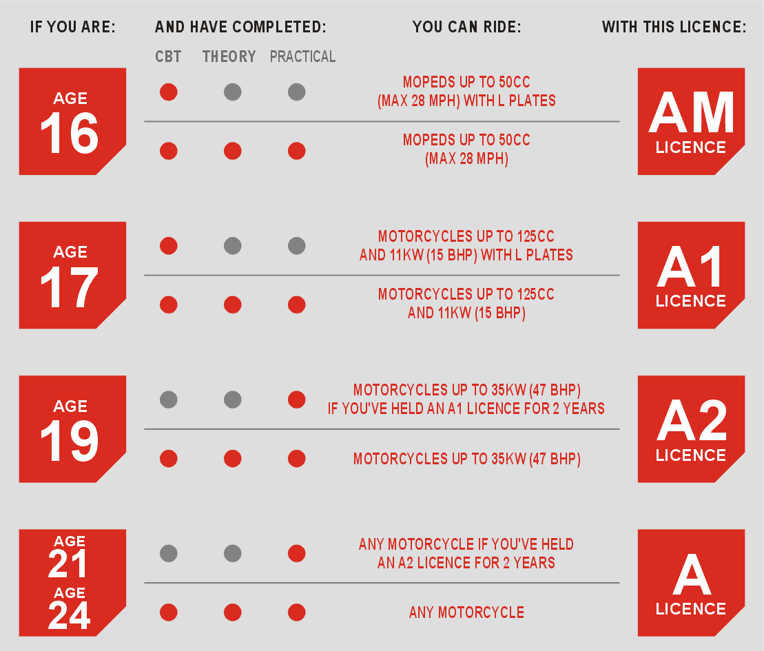
Why Agentic AI Is Needed
• Reads code + rules + docs
• Understands legal and regulatory constraints
(≤54 Hoarse Power , Road vs Race)
• Reprioritizes findings
Daniel Liezrowice – Agentic AI for CERT C – AI Hacking Village 2025

Slide 14

Why Agentic AI Is Needed
•what Agentic AI tool I use and why?
•Amp by Sourcegraph
•
Daniel Liezrowice – Agentic AI for CERT C – AI Hacking Village 2025

Slide 15

Why Agentic AI Is Needed
•what Agentic AI tool I use and why?
•why?
Many reasons but mainly because it doesn’t hallucinate
And doesn’t interduce security issues to the modified /generated code
•Amp by Sourcegraph
Daniel Liezrowice – Agentic AI for CERT C – AI Hacking Village 2025

Slide 16
Why Agentic AI Is Needed
•Amp by Sourcegraph
•what Agentic AI tool I use and why?
•why?
Many reasons but mainly because it doesn’t hallucinate
AMP does not generate free-form answers.
It only returns material that already exists in the indexed code or documentation.
The system runs deterministic code search and retrieval.
If a term, symbol, path, or pattern does not exist, AMP returns “no results,” not an invented answer.
Even when paired with an LLM, AMP constrains the model to operate on retrieved documents only. The model is not allowed to fabricate content outside the indexed corpus.
Execution paths inside AMP include validation steps that reject responses not grounded in source code or retrieved context.
In effect, AMP behaves more like a search engine and code browser with optional LLM summarization, not a generative assistant. Therefore the output is anchored to real repository data, which is why you do not observe hallucinations.
Daniel Liezrowice – Agentic AI for CERT C – AI Hacking Village 2025

Slide 17
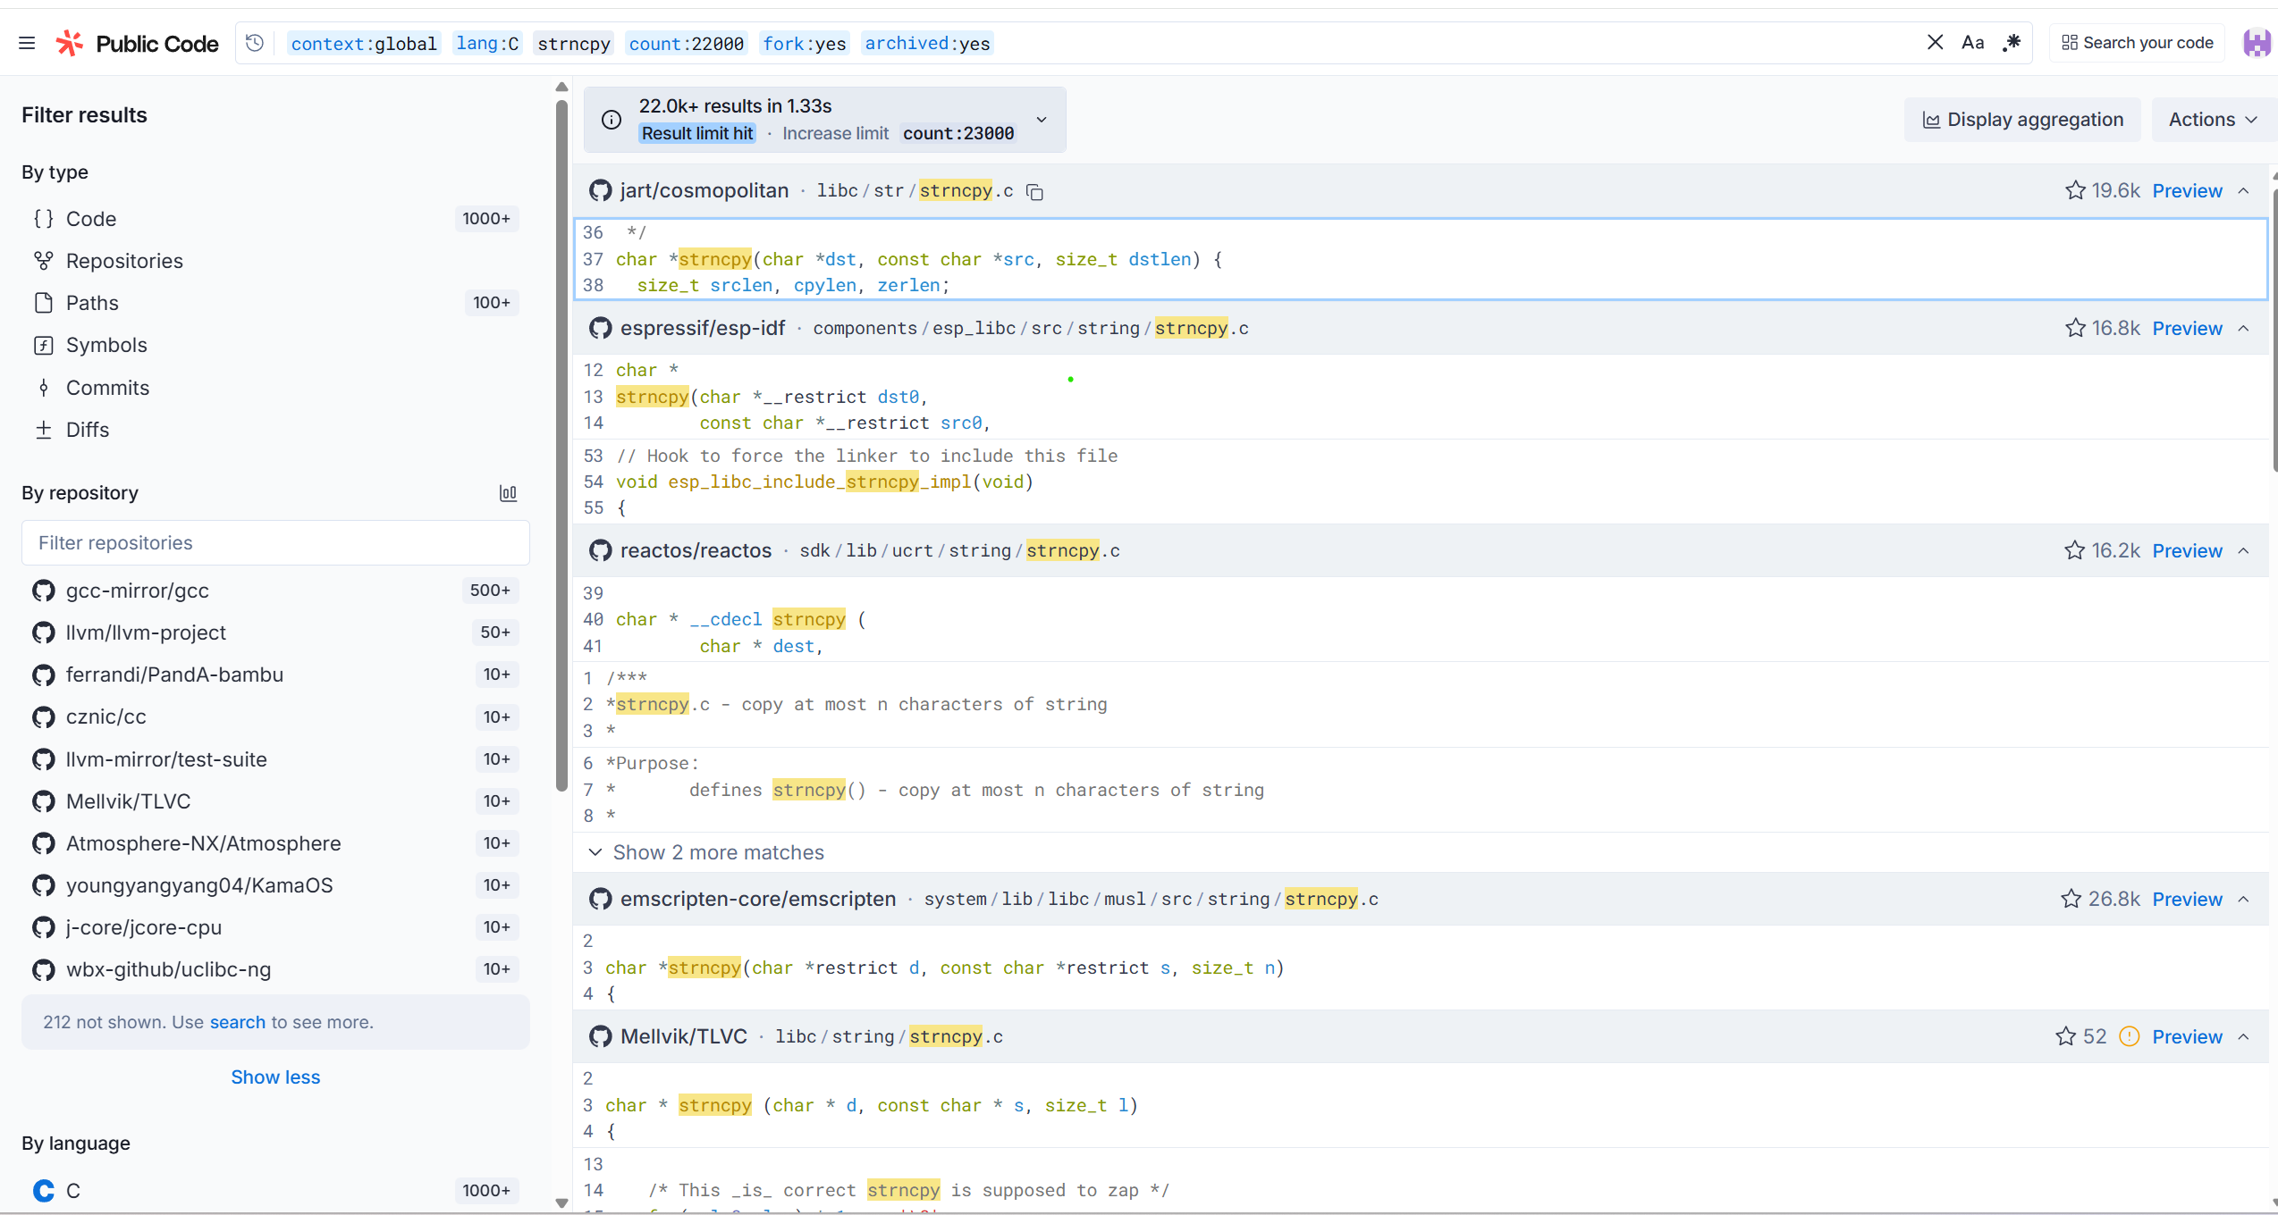
Why Agentic AI Is Needed
•Amp by Sourcegraph
•what Agentic AI tool I use and why?
•why?
Daniel Liezrowice – Agentic AI for CERT C – AI Hacking Village 2025

Slide 18

Demo Overview
Daniel Liezrowice – Agentic AI for CERT C – AI Hacking Village 2025

Slide 19
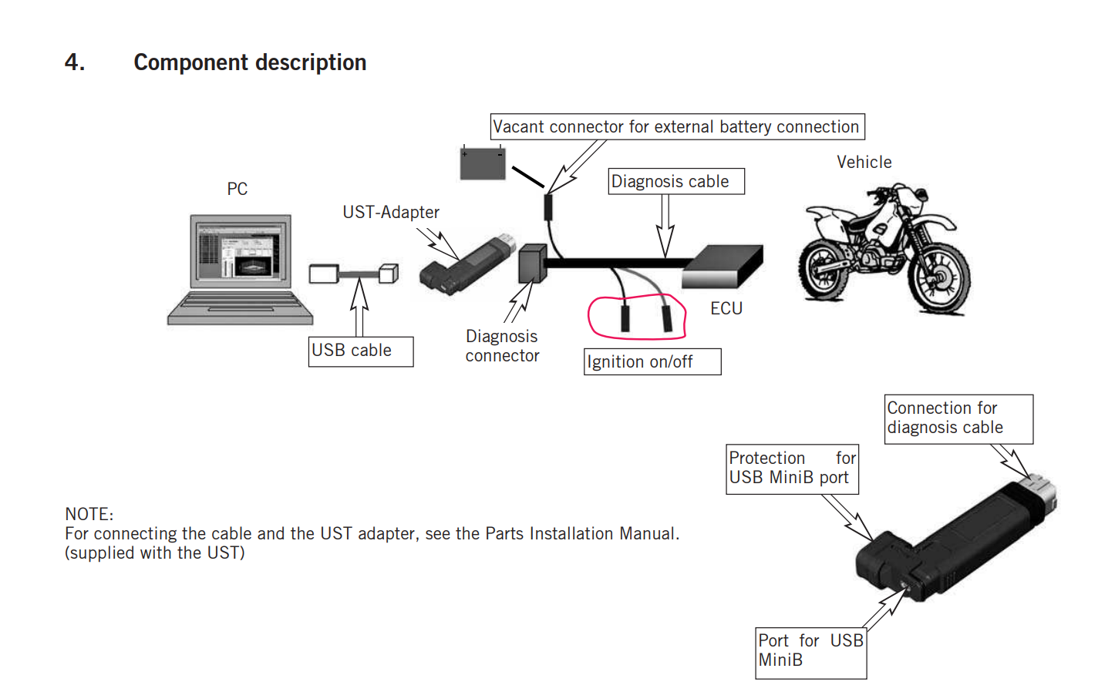
Why Agentic AI Is Needed
• Reads code + rules + docs
• Understands constraints (≤54 HP)
• Reprioritizes findings
Daniel Liezrowice – Agentic AI for CERT C – AI Hacking Village 2025

Slide 20

Why Agentic AI Is Needed
• Reads code, understand how is
everyone else is using similar code
+ rules + docs.
Enter Amp….
•
Daniel Liezrowice – Agentic AI for CERT C – AI Hacking Village 2025

Slide 21
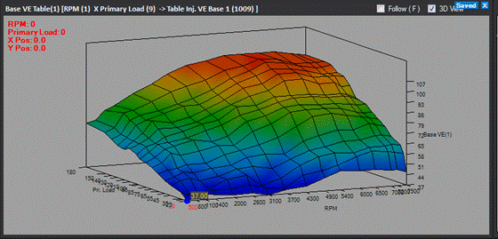
Demo Overview
• C program, Embedded ECU sim + Python GUI
• Engine Maps ROAD ≤54 HP
• Engine Maps RACE 65–100 HP
Daniel Liezrowice – Agentic AI for CERT C – AI Hacking Village 2025

Slide 22
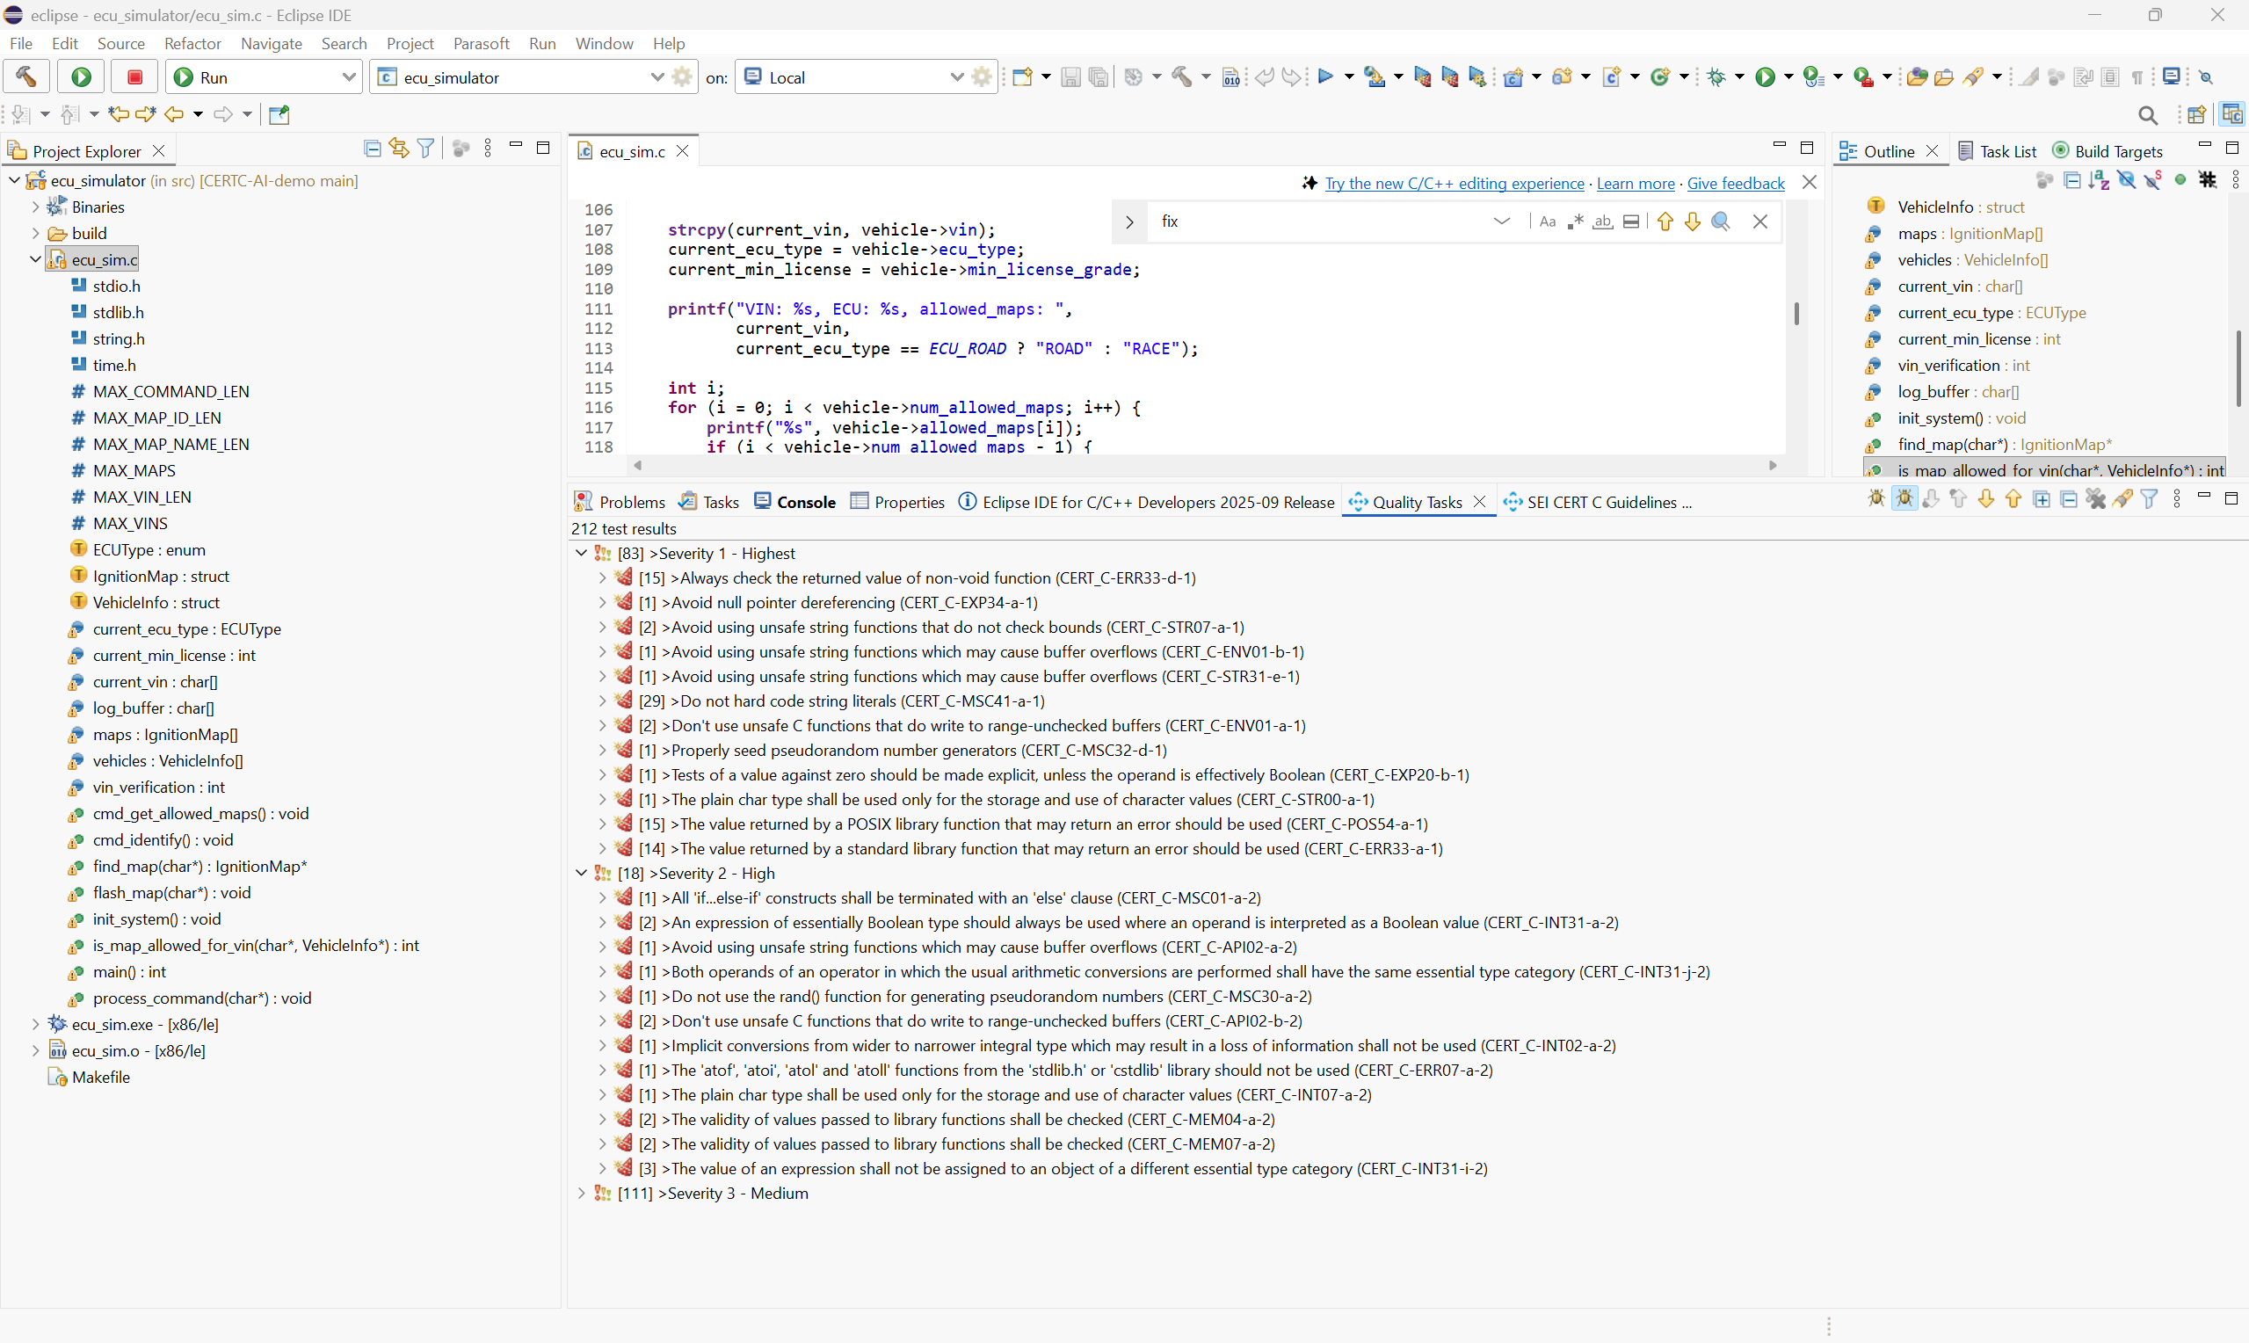
Static Analysis Results
• Many high-severity items
• Medium-severity missing-else is true danger
Daniel Liezrowice – Agentic AI for CERT C – AI Hacking Village 2025

Slide 23
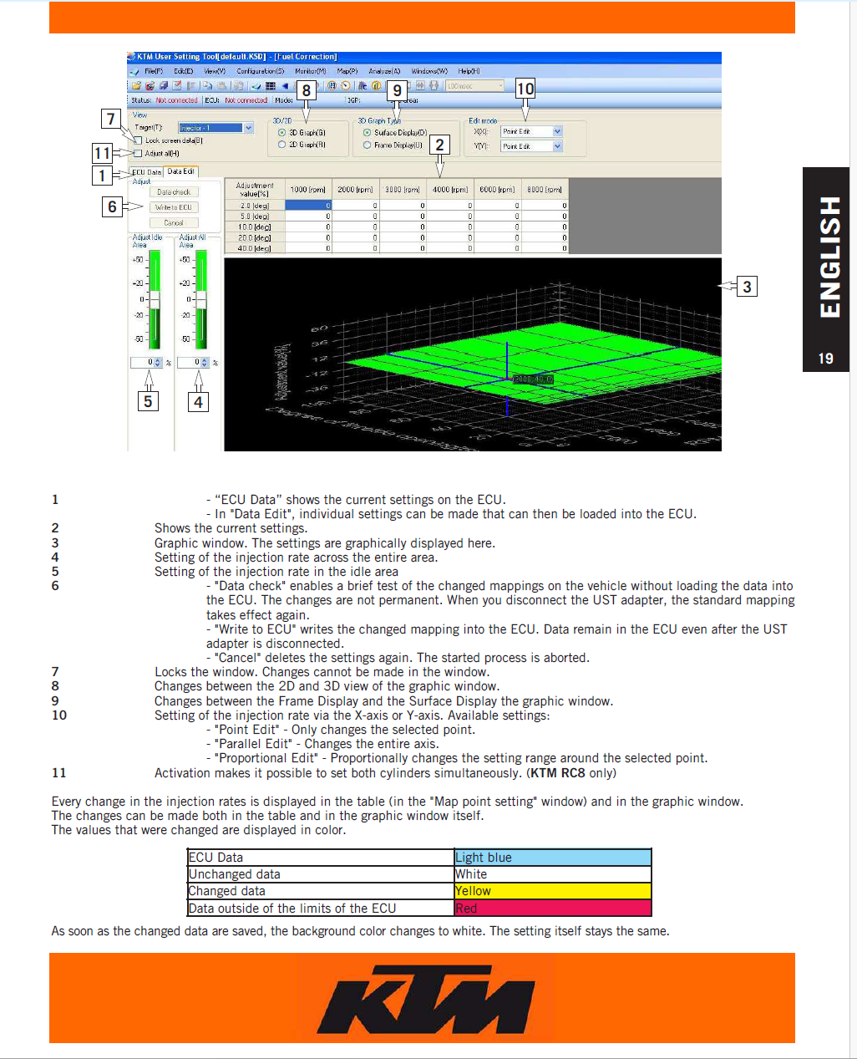
Demonstrating the Backdoor
• ROAD ECU exploited
• Malformed input bypasses VIN check
Daniel Liezrowice – Agentic AI for CERT C – AI Hacking Village 2025

Slide 24
Root Cause
• Missing ELSE path
• scanf misuse
• Uninitialized logic
Daniel Liezrowice – Agentic AI for CERT C – AI Hacking Village 2025

Slide 25
Why Static Severity Misleads
• Backdoor labeled MEDIUM
• Irrelevant highs
• No domain knowledge
Daniel Liezrowice – Agentic AI for CERT C – AI Hacking Village 2025

Slide 26
Agentic AI Analysis
• Understands 54 HP law
• Analyzes program intent
• Detects violation
Daniel Liezrowice – Agentic AI for CERT C – AI Hacking Village 2025

Slide 27
AI-Generated Fix
• Validate scanf
• Complete else-chain
• Reject illegal HP
Daniel Liezrowice – Agentic AI for CERT C – AI Hacking Village 2025

Slide 28
Reprioritization Results
• Backdoor elevated to critical
• Noise remains low
Daniel Liezrowice – Agentic AI for CERT C – AI Hacking Village 2025

Slide 29
Demo Flow Summary
• Static → exploit → AI → fix sequence
Daniel Liezrowice – Agentic AI for CERT C – AI Hacking Village 2025

Slide 30
Key Takeaways
• Severity ≠ risk
• AI adds reasoning
Daniel Liezrowice – Agentic AI for CERT C – AI Hacking Village 2025

Slide 31
Closing
• AI finds what matters
• Better prioritization = safer systems
Daniel Liezrowice – Agentic AI for CERT C – AI Hacking Village 2025

Slide 32
Closing
Thank you for listening
• Better prioritization = safer systems
Daniel Liezrowice – Agentic AI for CERT C – AI Hacking Village 2025

